Slide 1


Mike Surrey
Chair - Alncom

Slide 2
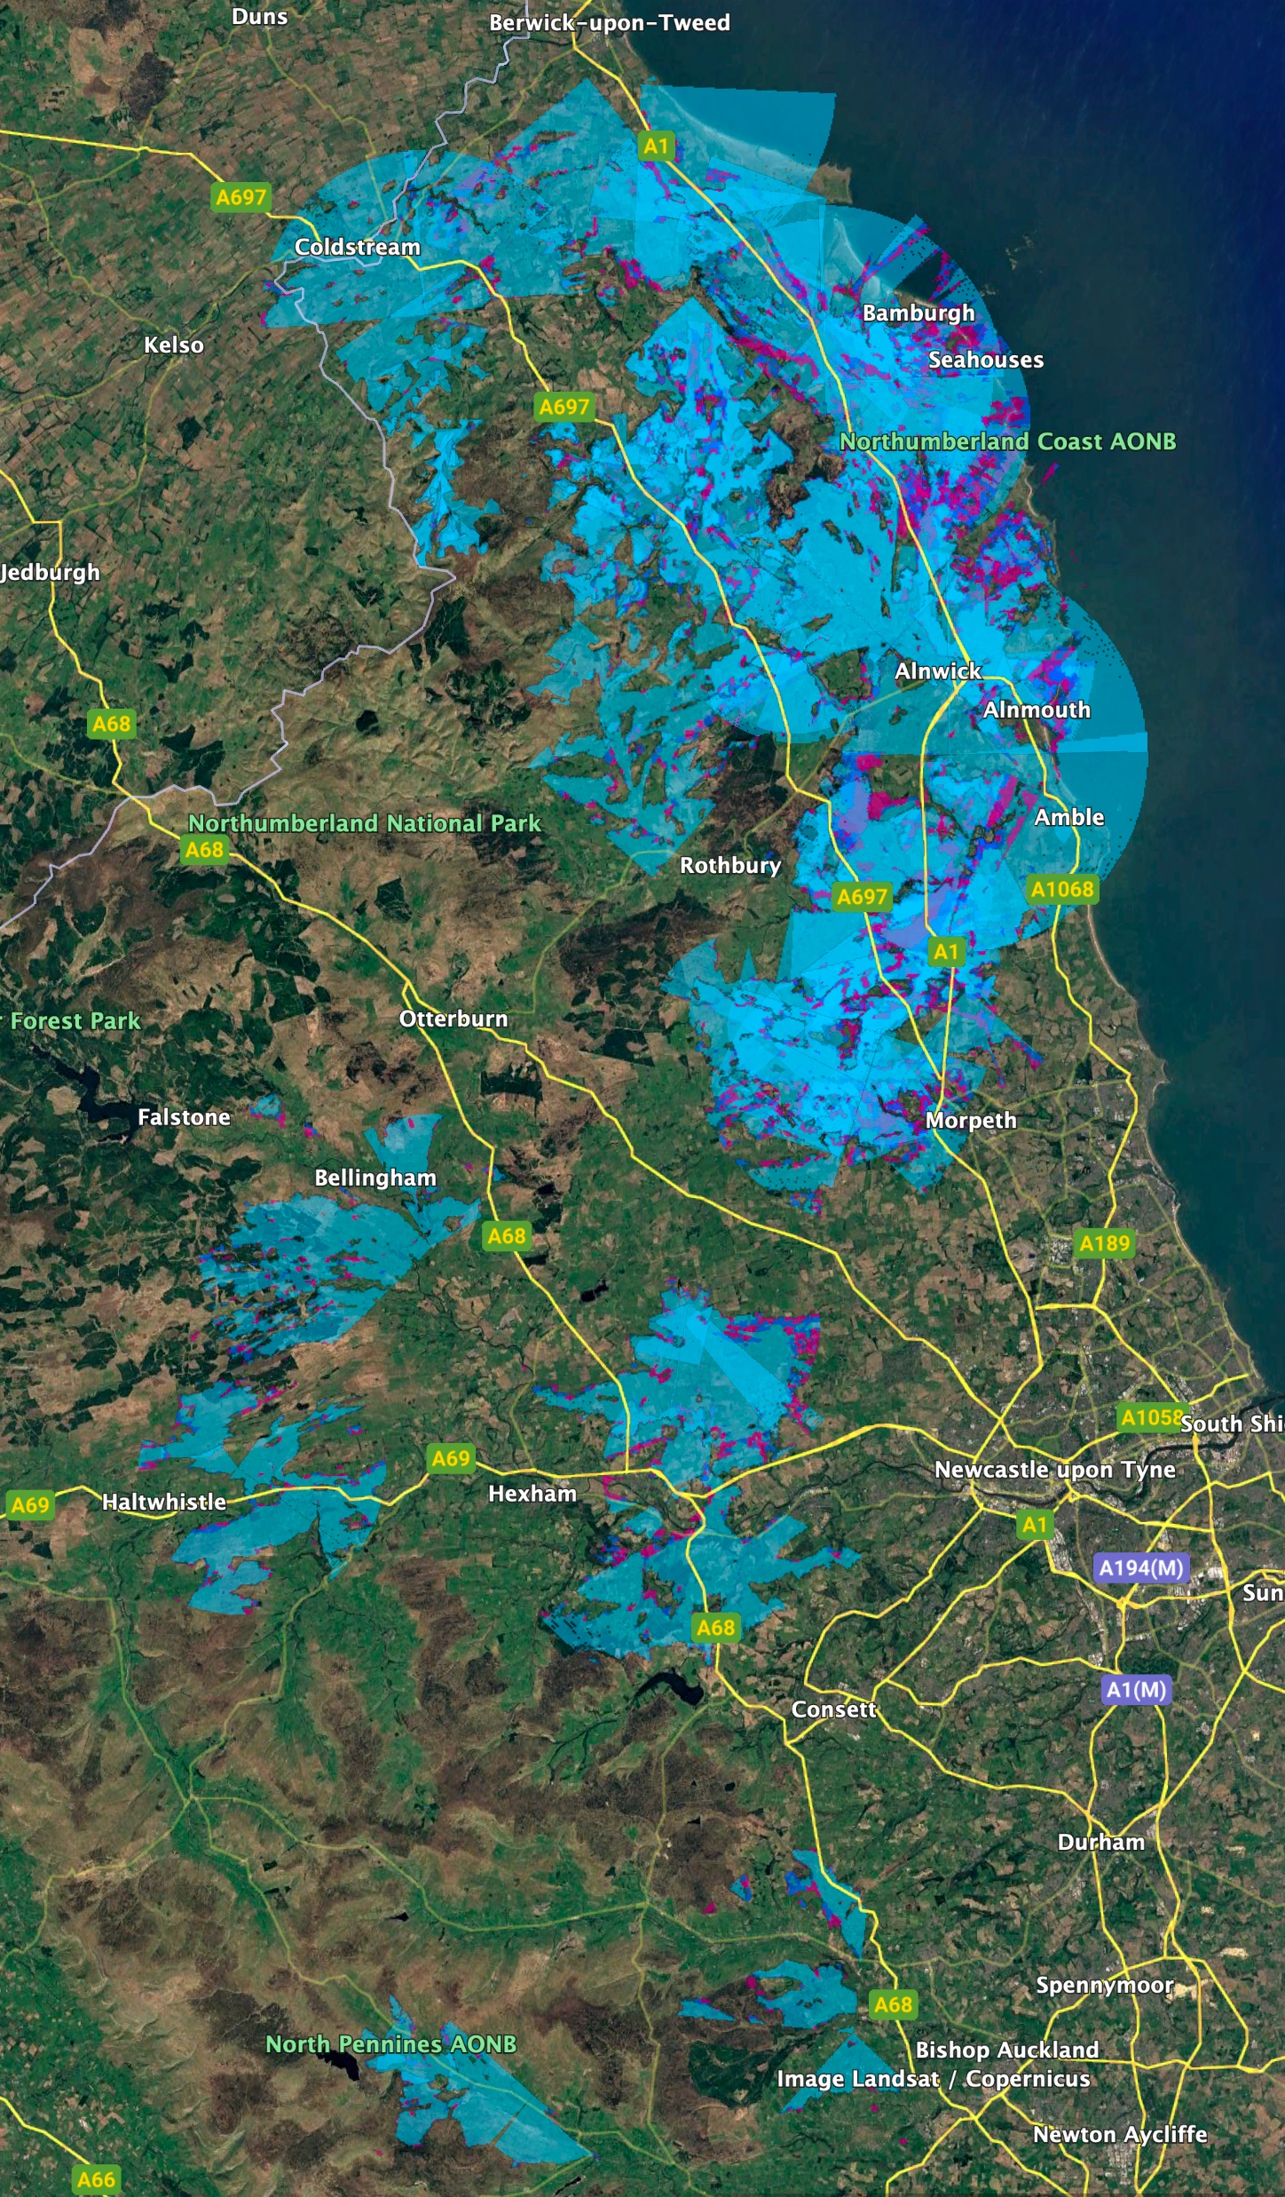
Heritage as a WISP
.
Started as Alnwick Computerware 40 years ago.
Business Customers demanded better connectivity for IT services.
Expanded as a Retail WISP utilising rural voucher scheme serving 1000+ Customers
Evolved into a FTTP Network in 2021.

Slide 3


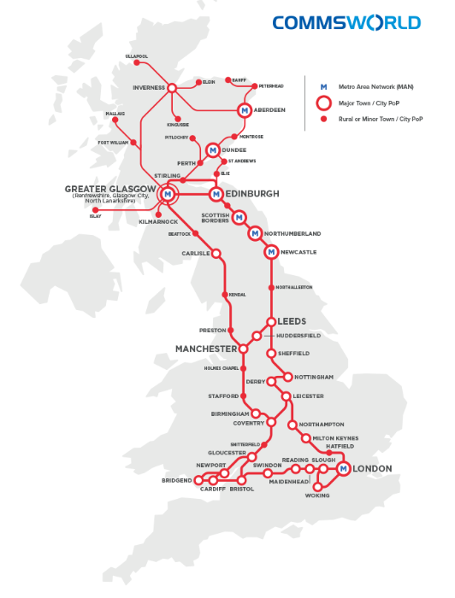




Key Partners
.

Slide 4
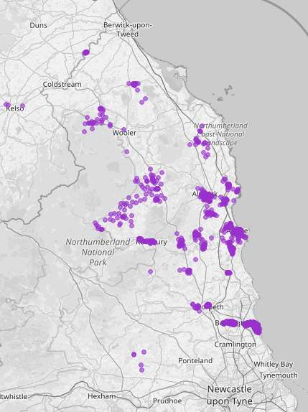
Ultra Rural Fibre Networks
.
Fibre Build started in 2021
33,000 Homes Passed
15,000 Homes RFS
5,000 Fibre Customers
800 FWA Customers
1,019KM of Fibre network

Slide 5
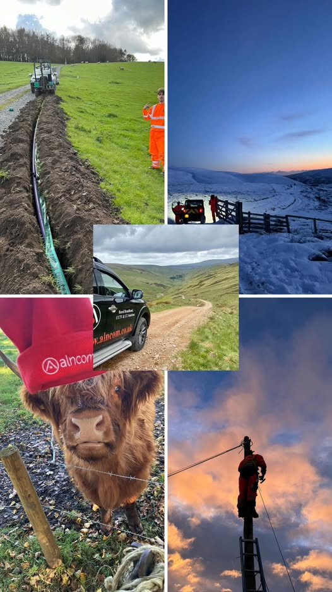
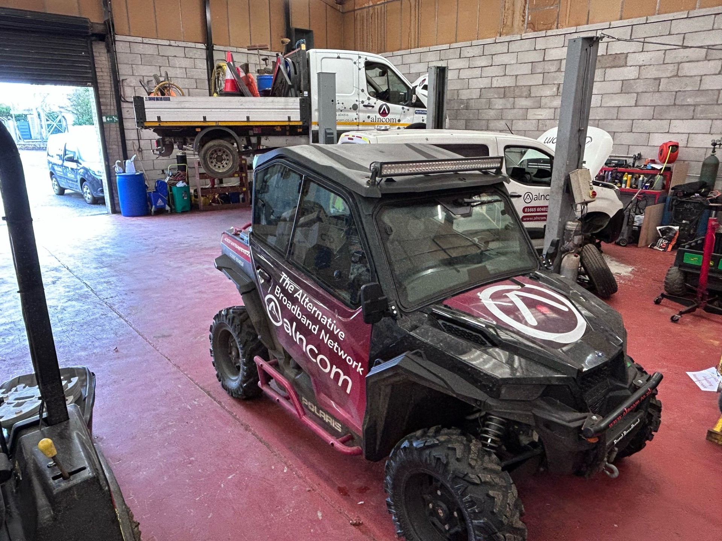
In House Build Team and Machinery
.

Slide 6


Trusted Challenger Brand
.

Slide 7
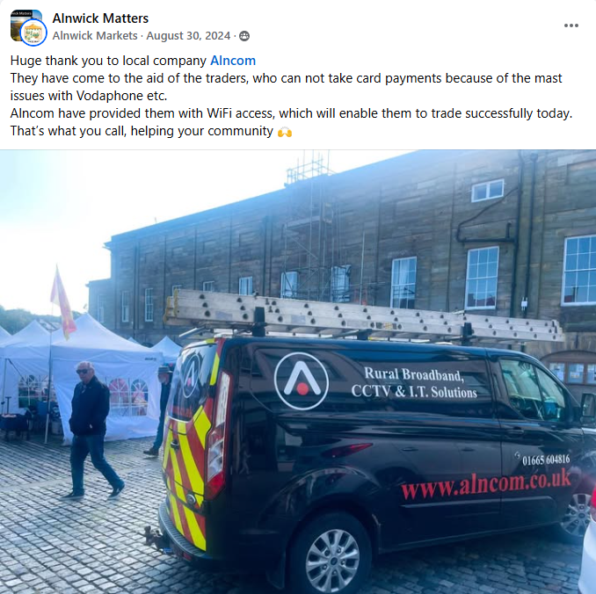

Supporting the Local Community
.

