Slide 1
18th March 2025
SCTE

Slide 2
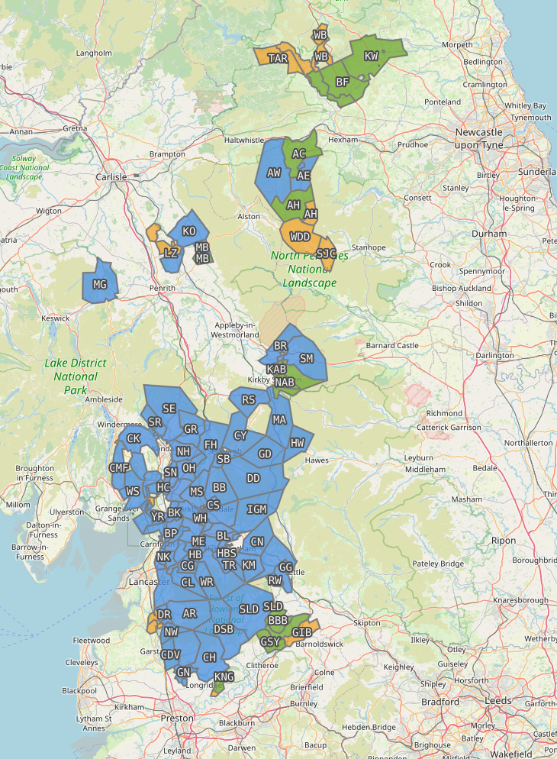
Business Model
Mission. To deliver the best internet service in the country to the areas that are hardest to reach, working shoulder to shoulder with, and for, rural communities, to realise the enduring benefits of greater resilience and connectivity.
Community Benefit Society.
We are owned by our members. Each of our 3,400 members has invested between £100 and £100,000 in B4RN, and each member has equal voting rights at the AGM.
Currently we are focusing our resources on expanding the network and serving more communities, however any profit we make in the future must be re-invested back into our communities.
BUILT NETWORK
IN BUILD
DEVELOPMENT

Slide 3
Build Model
Deep rural. We work with deep rural communities that don’t have a viable alternative to achieving gigabit connectivity. When we deliver to a community, we offer a connection to 100% of the properties that we can reach in that community.
Community build. We build our network alongside these communities. We rely on the hard work and dedication of local volunteers, landowners and investors.
Sustainable build strategy. Each community build is self funding. We calculate the build cost and predict the level of government grants we will get through the Project Gigabit voucher scheme. We then work with the community to secure grants and raise investment to cover the funding gap.
BUILD COST
COMMUNITY
SHARES
BDUK & B4RN
Voucher priority area
Approved project
GRANTS
Community volunteers
Sign up
Community shares
Wayleaves
VOUCHERS

Slide 4
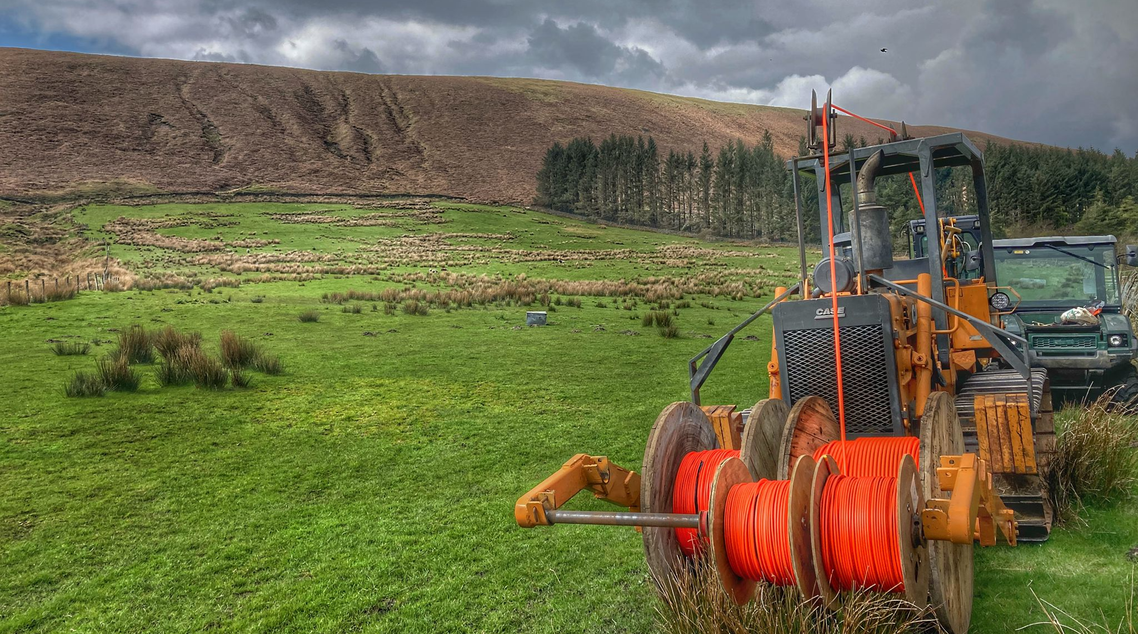
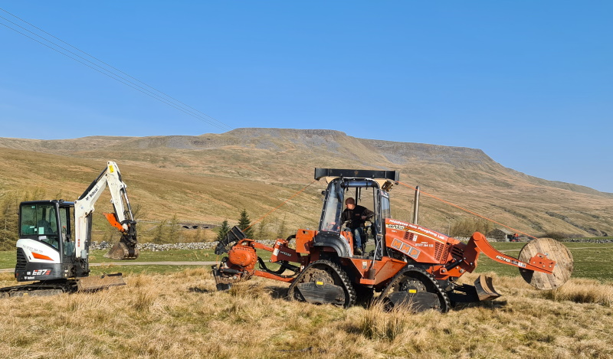
Build Methodology
Resilience and Redundancy. Our unique business model allows us to make a conscious decision to invest in enhancing resilience and redundancy in rural areas, creating a long-term sustainable asset.
Sub surface. The vast majority of the network runs through over 6,000 km of underground duct, laid in fresh ground using mole ploughs and hard dig.
PIA. We use a small amount of PIA, but this accounts for a small percentage of the total network footprint due to the availability of viable duct in rural areas.
XGS-PON. The foundation network is point to point fibre to every property. This enables us to deliver industry leading speeds today, and adopt new technologies as they become available. We are in the process of rolling out XGS-PON with Nokia as our supplier partner of OLT and ONTs.

