Slide 1
Simplicity and Speed: Winning at Rural FTTX
Ian Cowser, FTTx UK Programme Manager
March 2025

Slide 2
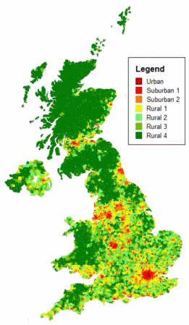
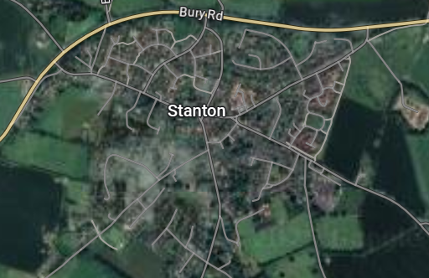


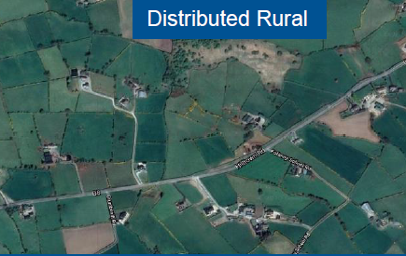

What is Rural?
Hamlet
Distributed Rural

Slide 3
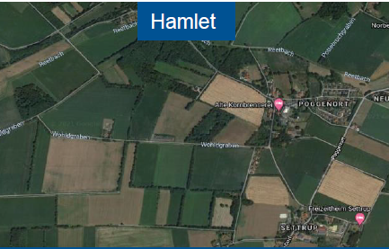

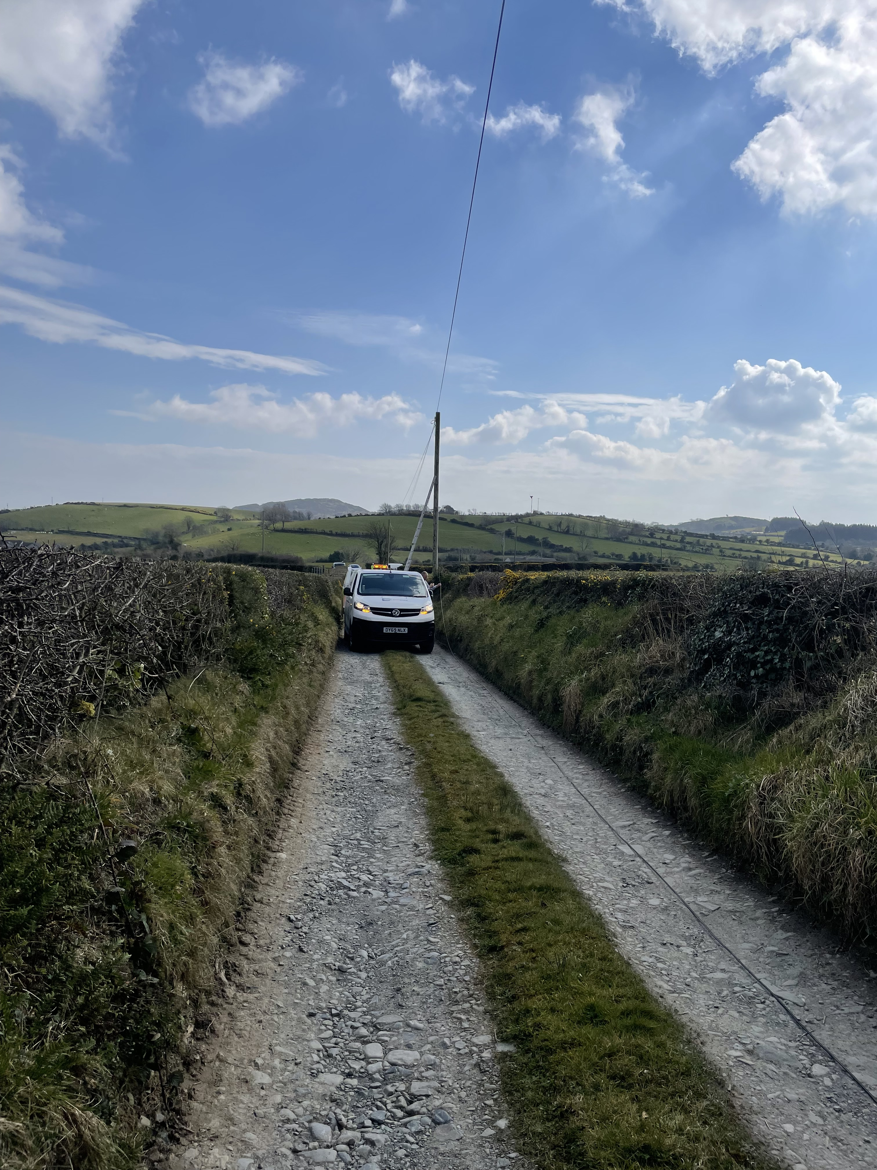
What is Rural?
Hamlet
Distributed Rural

Slide 4
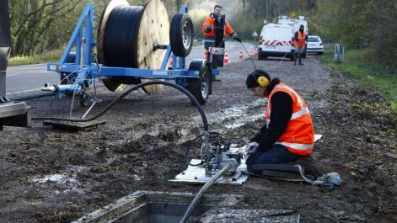

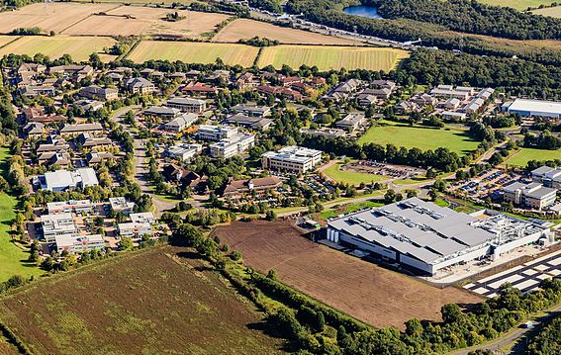
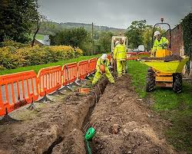
Further Challenges Deploying in Hard-to-Reach Areas
Distance from Exchange/POP
Long distances increase time to deploy, total materials used which increases cost
Infrastructure Limitations
Less existing infrastructure e.g., footway boxes and poles - shared user permissions
Potential risk for congestion with future overbuild
Environmental & Regulatory Issues
Challenging terrain complicates installation – OH + UG transitions
Obtaining permits is time-consuming due to strict regulations
Maintenance Challenges
Fibre maintenance in hard-to-reach areas is more difficult and costly
4

Slide 5

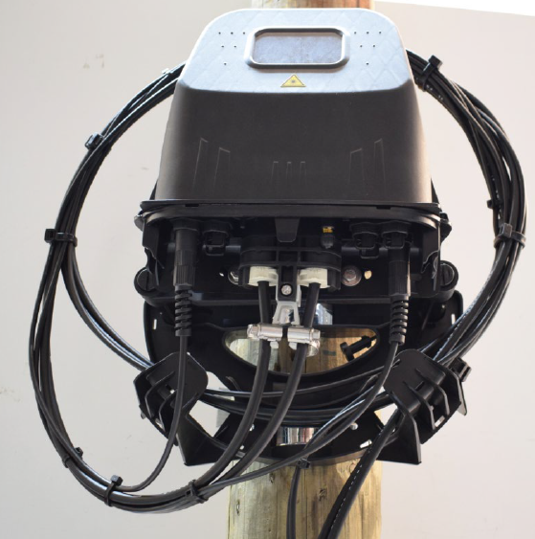


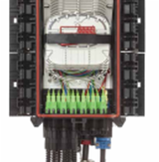
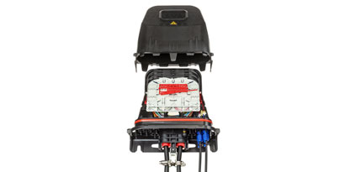
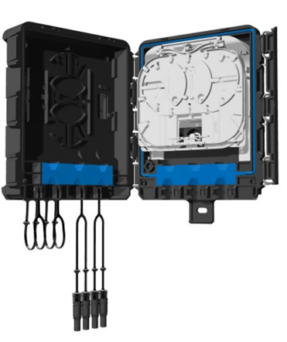
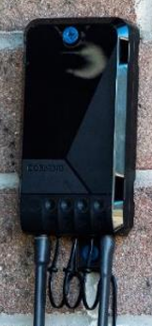
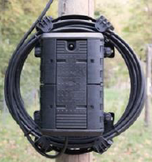
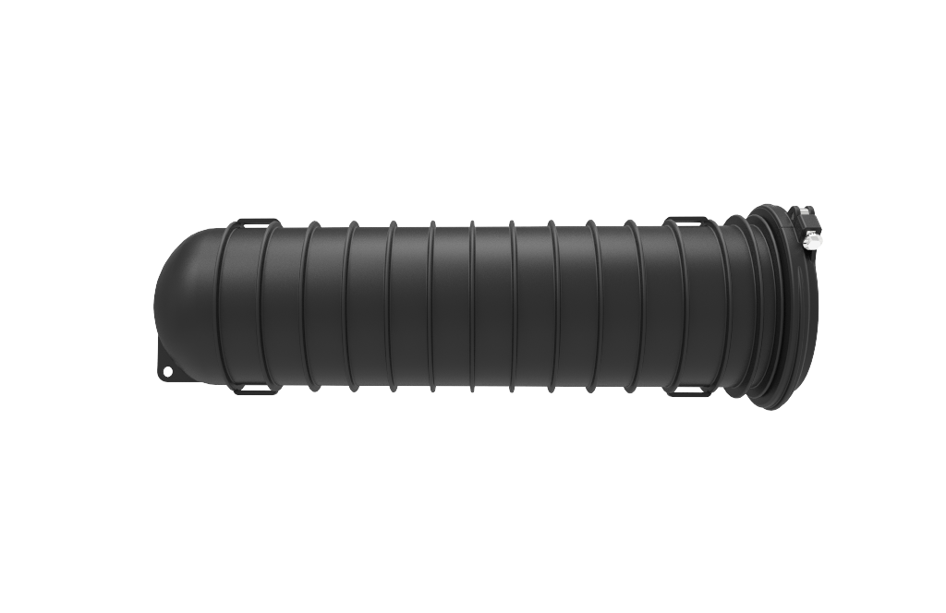


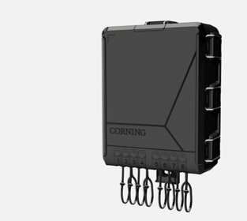

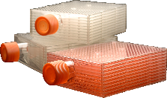
Hamlet Type Rural FTTH Architecture – allows for central split and cascaded together
Primary Splitter node/NAP using BPEO with pushlok ports.
Contains 1:8 (or 1:32 for village if preferred) and branching splices
Smaller secondary splitter
node/DP using openable
pushlok
Aerial fibre
Secondary splitter
node/DP using BPEO with pushlok port to accommodate branch splice
Evolv Splitter node/DP – addressing
aesthetic and size constrains in villages

Slide 6


Distributed Rural FTTH Architecture - Spliced cascaded split,
ultra rural
/ /
Splitter node/DP
Smaller splitter node/DP
EOT
Aerial fibre
“Ultra Rural” – remote farms & homes
Longer drop lengths
An easy pass through & drop functionality
Smaller splitter node/DP

Slide 7
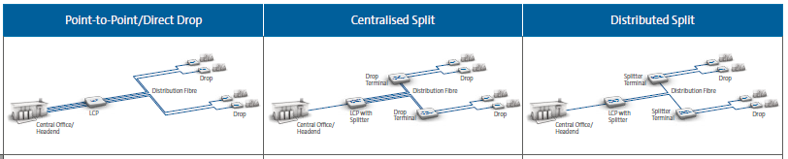
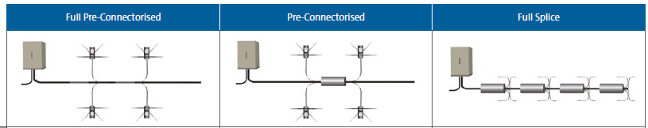
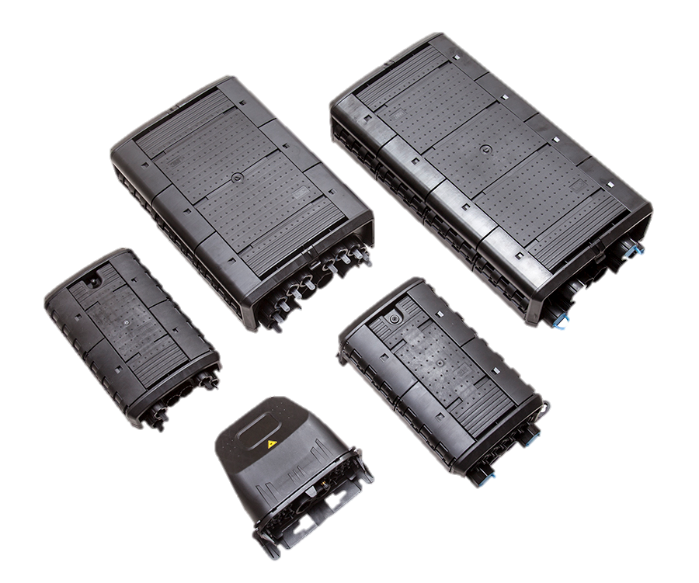
How to Optimise ?
Point-to-Point/Direct Drop
Centralised Split
Distributed Split
Commonalities
Dominated by aerial distribution cable, but both typically include some UG, road crossings, interactions with power networks etc. Components need to deal with both.
Very long fibre loops. Both need some element of pass through / distributed ODPs, much more so on distributed rural
Full Pre-Connectorised
Per-Connectorised
Full Splice
Hardware Selection Is Key:
Modularity – Same platform for different applications
Flexibility - same plant caters for all architectures
Cable and network design transparent

Slide 8
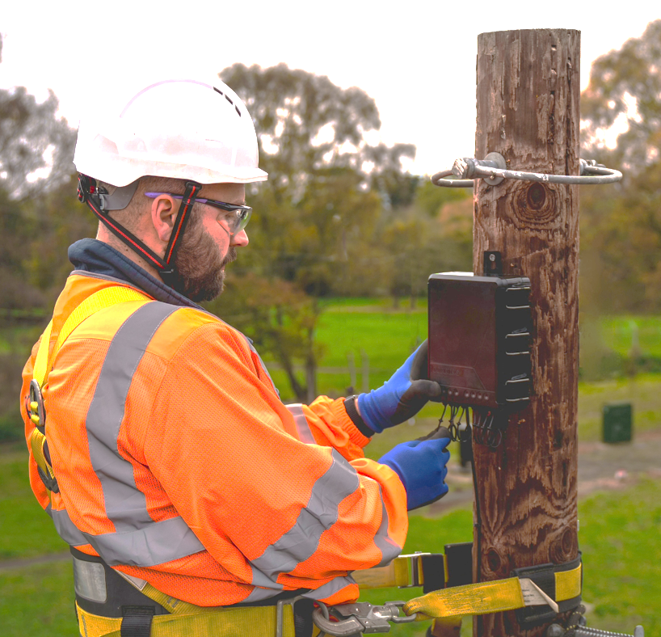

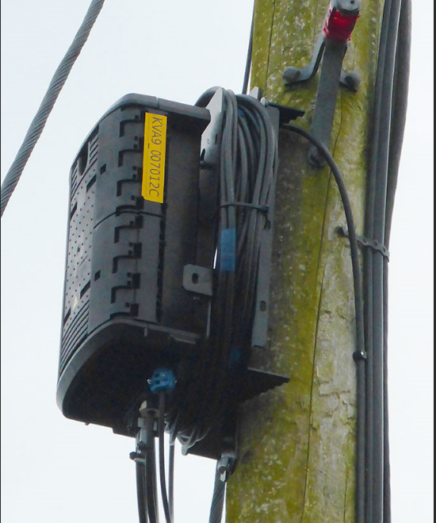
How Corning Can Help – Experience & Support
Equipment designed around the needs of rural deployments:
Interchangeable between UG and OH
Simplify SKUs
Allow flexibility for build teams
External cable prep & zero splicing at height
Expansion capacity – storage & expansion

Slide 9






Key Takeaways
Deployment Focus on Rural Areas
Rural FTTX makes up ~30% of total FTTP coverage in UK
Challenges in Different Types of Rural
Varied landscapes include small villages (Hamlets) and isolated properties (Ultra-Rural), each with unique challenges
Corning helps accelerating and reducing costs in Rural Deployments
Corning offers End-To-End solutions with modular flexibility that help to accelerate and reduce costs in rural deployments
Evolv® Openable Terminals (EOTs), BPEO’s Closure Platform
Ideal for rural areas featuring flexible designs, commonality of components, Pushlok® technology, factory-terminated ports, and IP68 ratings
9

