Slide 1


Slide 2

K3 Telekom:
Broadband going Rural
Boris Stipetić, CEO K3 Telekom
SCTE, Zagreb, Oct.2013.

Slide 3
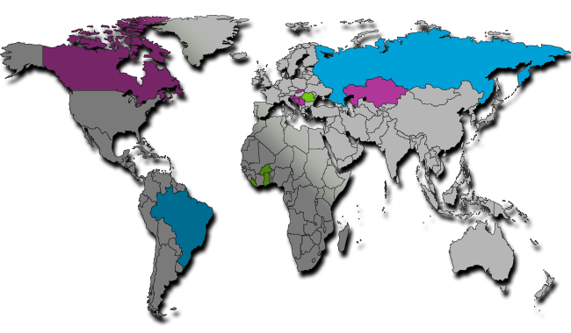
K3 Tele.com

Slide 4
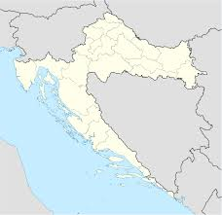
K3 Telekom: Broadband going Rural

Slide 5
Digital agenda - Broadband access
Basic broadband (<2Mbps) coverage ⇒ 100% by 2013.
Fast broadband (>30Mbps) coverage ⇒ 100% by 2020.
Ultra fast broadband (>100 Mbps) take up ⇒ 50% by 2020.

Slide 6
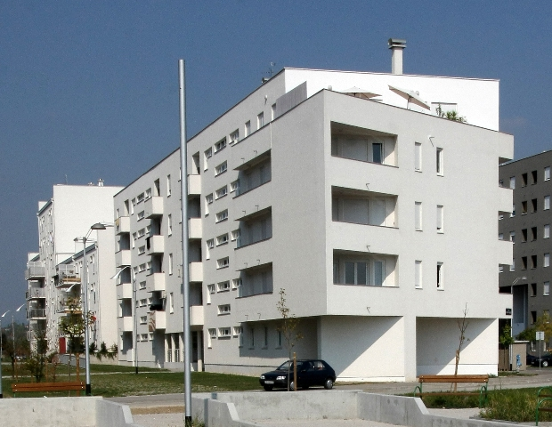

Slide 7
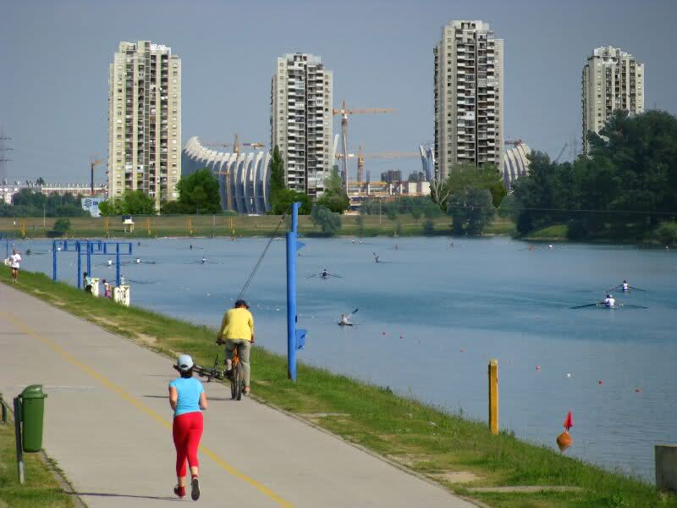

Slide 8
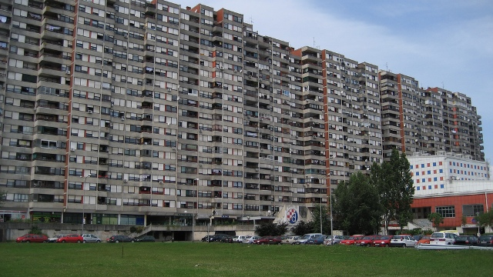

Slide 9
Market Segment: Rural
The question is where to find new customers?
There are a lot of population left uncovered by fast broadband fixed lines, but…
…how to connect people living in places like:

Slide 10
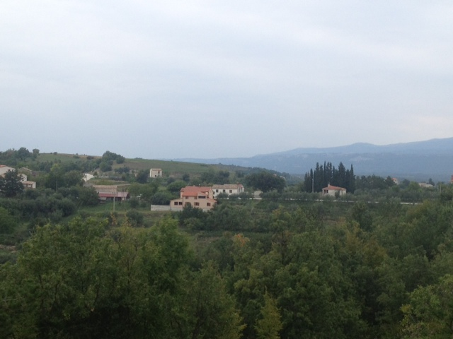

Slide 11
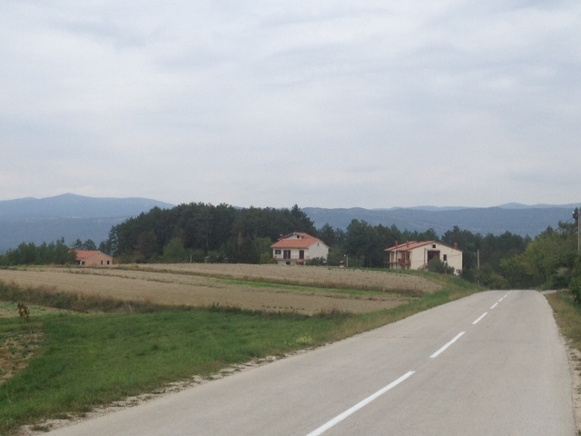

Slide 12
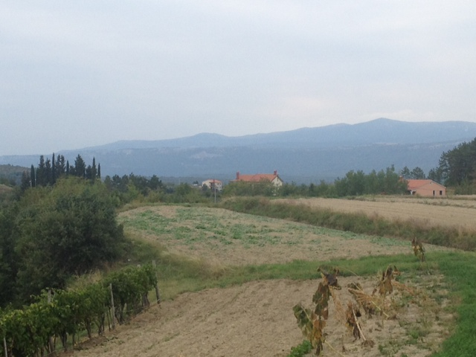

Slide 13
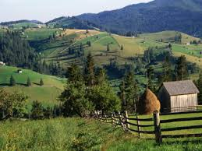


Market Segment: Rural
How to bring fixed fast BB in such rural area and keep the business case?

Slide 14
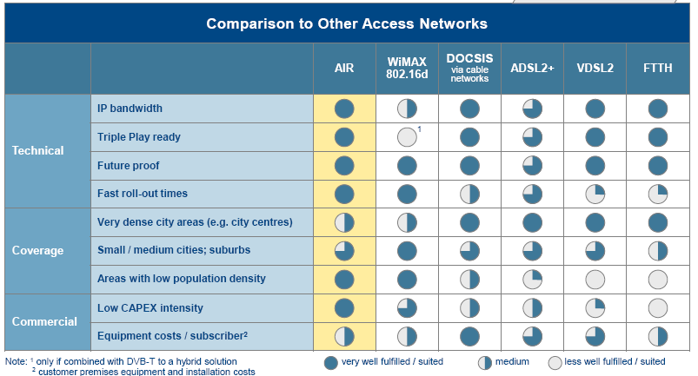
Market Segment: Rural

Slide 15
AIR Technology
P2MP system
300 MHz spectrum
37 channels / 8 MHz each
DVB-C, MPEG-4
Eurodocsis, SIP

Slide 16
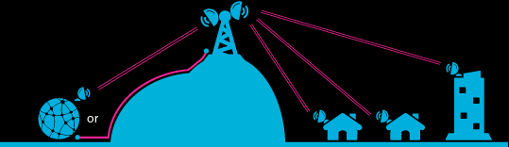
K3 Telekom Access Network
P2MP access network

Slide 17
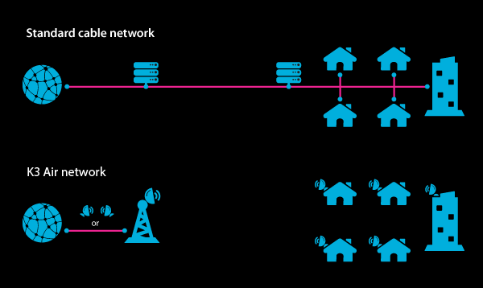
K3 Telekom Access Network

Slide 18
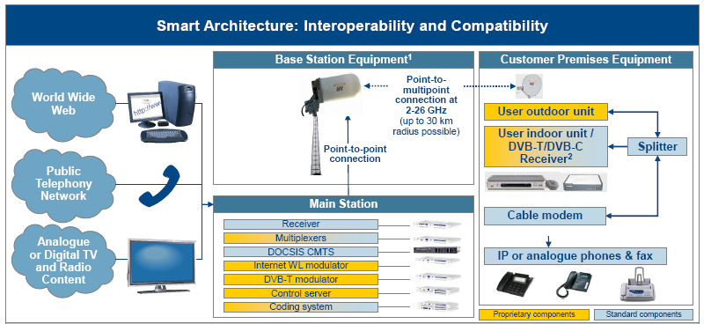
K3 Telekom: Network Architecture

Slide 19
K3 Telekom
K3 Telekom access network => Air technology
μW range: 10.0 – 10.3 GHz
Baseband range: 300 MHz => 37 ch, 8MHz each
> 60 TV channels (SD + HD)
Brodaband Internet access (EuroDocsis ): 4, 6, 8 Mbps
Fast roll-out (whole network in 3 months)

Slide 20
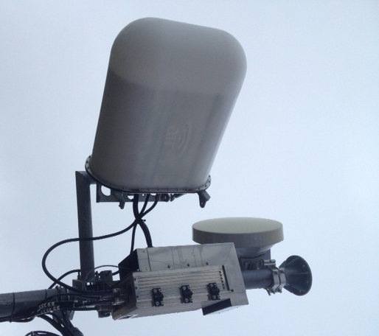
K3 Telekom Network Equipment
Equipment used
Edge QAM ( TV , DVB-C)
CMTS (Internet, EuroDocsis)
SoftSwich (Voice service, SIP)
AIR base station

Slide 21
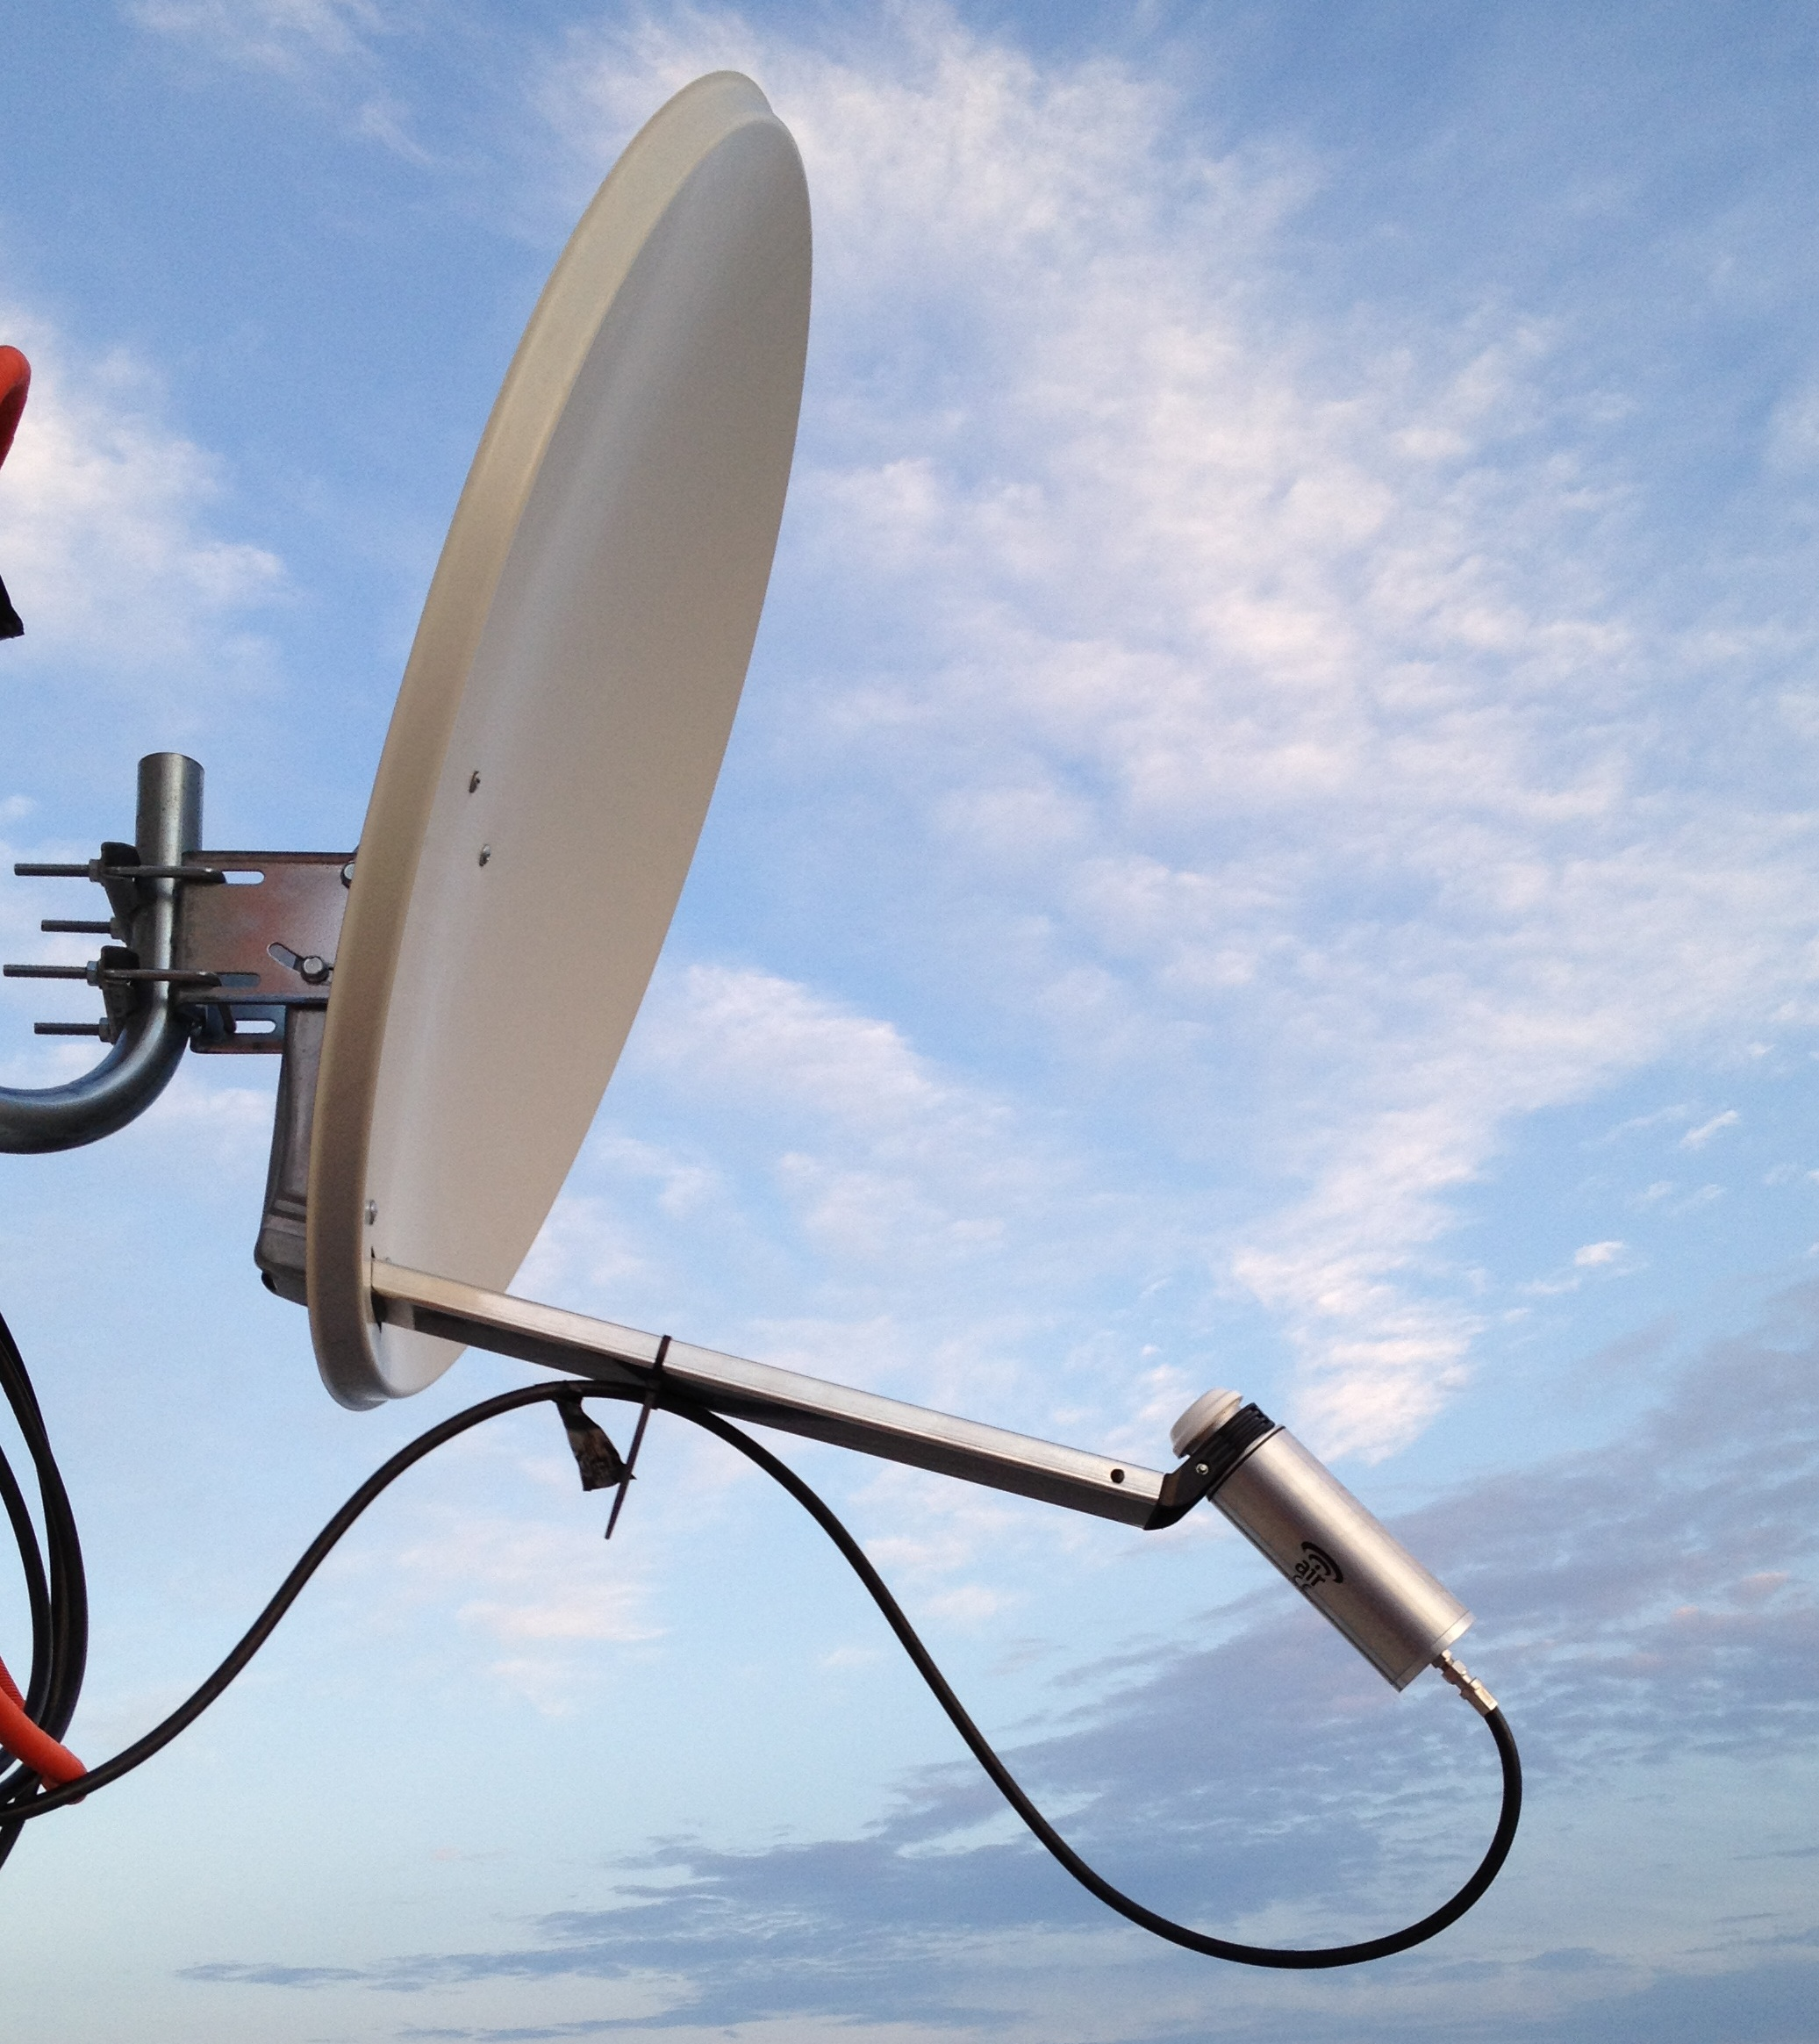
K3 Telekom CPE
Equipment used
Antena (satelite dish)
Air transciever (TxRx)
DVB-C STB
Cable modem (net+voice)

Slide 22
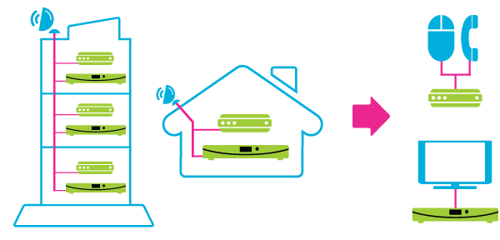
K3 Telekom CPE
Standard telecom equipment for the end user

Slide 23
K3 Telekom: Broadband going Rural
Provisioning – the same as for Cable TV (HFC)
Whole network structure the same as for CaTV network, except last hop – radio
Superior service quality – high customer satisfaction
Rural area fully reachable

Slide 24


Slide 25

Thank you.
Boris Stipetić, CEO
K3 Telekom
boris@k3telekom.hr

